Slide 1
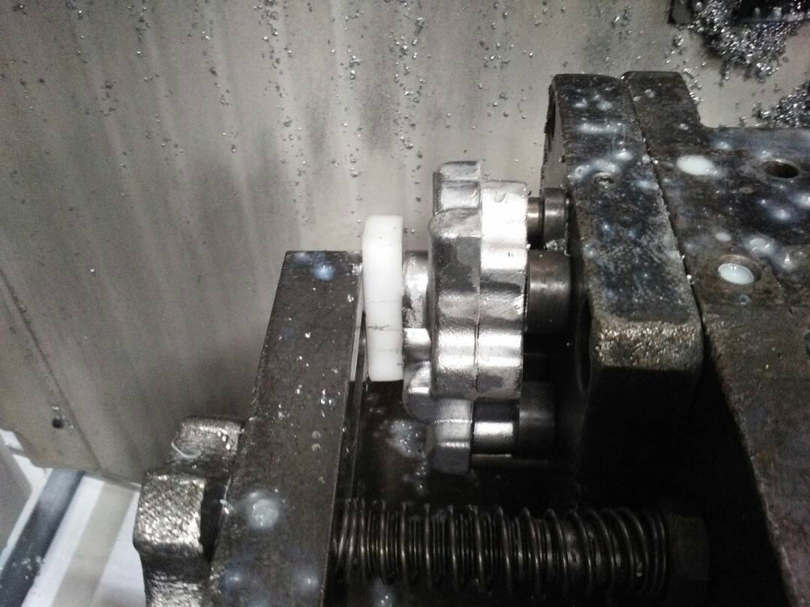
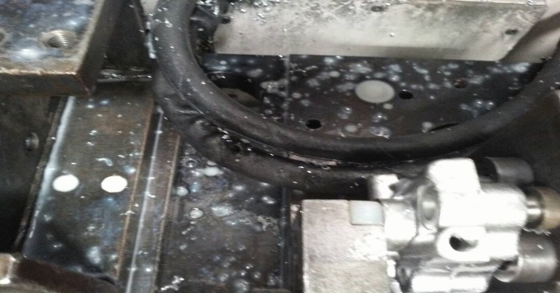
P15
KAIZEN NO :-
ACTIVITY
KK
QM
PM
JH
SHE
OT
DM
E&T
KAIZEN IDEA SHEET
TPM CIRCLE NAME: Achiever
LOSS NO. / STEP
DEPT :- MACHINE SHOP
RESULT AREA
P
Q
A,B,C
C
D
S
M
CELL:- Oil Pump
CELL NAME:- A202b
MACHINE / STAGE :- Br. Machine
OPERATION :- Machining.
KAIZEN THEME : To Eliminate Rejection At Face Damage Rejection.
IDEA :- . Use nylon pad for End of Face.
Problem / Present Status :-
In Present Process A202B Machining High Rejection for Face Damage during Machining.
COUNTERMEASURE :- Use nylon pad for End of Face metal clamp .
BENCHMARK
168nos
TARGET
0
KAIZEN START
10.04.2017
KAIZEN FINISH
04.05.2017
TEAM MEMBERS :
Nilesh Khadke,
Dilip Phapale, Sagar Namekar.
BENEFITS :-
Rejection cost Reduced.
After
KAIZEN SUSTENANCE
WHY - WHY ANALYSIS :-
Why1 :- A202B Face Damage.
Why2 :- Face Damage During Clamping.
Why3 :- Metal Button Used for Clam.
Why4 :- Fixture Basic Design in Metal Clamp.
RESULT :-
1) Rejection Eliminate.
WHAT TO DO:- Use nylon pad for End of Face metal clamp
HOW TO DO :- Daily Monitoring
ROOT CAUSE :- .
Metal clamp used
REGISTRATION NO. & DATE : 04.05.2017
SCOPE & PLAN FOR HORIZONTAL DEPLOYMENT
REGISTERED BY :- Umesh Pimple
SR.
NO.
CELL
TARGET
RESPONSIBILITY
STATUS
MANAGER’S SIGN :- D. Y. Pawar
1
---------
-------
---------
--------

Slide 2
ACKNOWLEDGEMENT
Your Question’s and Suggestion's are most Welcome

